Slide 1
pySubnetSB: A Python Package for Finding Sub-Networks in SBML Models
Joe Hellerstein
Nov, 2024

Slide 2
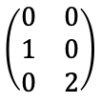
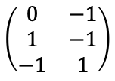
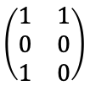
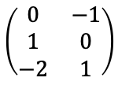
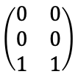
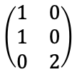
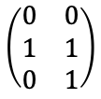
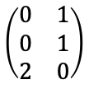
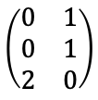
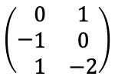
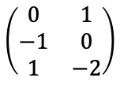
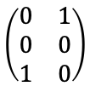
Definitions of “Structurally Identical Networks”
Network A
J1: S1 + S2 -> S1 + S3
J2: S3 + S3 -> S1
Network B
J1: S3 + S3 -> S2
J2: S1 + S2 -> S2 + S3
Network C
J1: S2 -> S3
J2: S3 + S3 -> S1
Network D
J1: S3 + S3 -> S3
J2: S1 + S2 -> S3
product
reactant
difference
product
reactant
difference
product
reactant
difference
product
reactant
difference
$$\left(\begin{matrix}1 & 1 \\ 0 & 0 \\ 1 & 0\end{matrix}\right)$$
$$\left(\begin{matrix}1 & 0 \\ 1 & 0 \\ 0 & 2\end{matrix}\right)$$
$$\left(\begin{matrix}0 & 1 \\ −1 & 0 \\ 1 & −2\end{matrix}\right)$$
$$\left(\begin{matrix}0 & 0 \\ 1 & 1 \\ 0 & 1\end{matrix}\right)$$
$$\left(\begin{matrix}0 & 1 \\ 0 & 1 \\ 2 & 0\end{matrix}\right)$$
$$\left(\begin{matrix}0 & −1 \\ 1 & 0 \\ −2 & 1\end{matrix}\right)$$
$$\left(\begin{matrix}0 & 1 \\ 0 & 0 \\ 1 & 0\end{matrix}\right)$$
$$\left(\begin{matrix}0 & 0 \\ 1 & 0 \\ 0 & 2\end{matrix}\right)$$
$$\left(−\begin{matrix}0 & 1 \\ 1 & 0 \\ 1 & −2\end{matrix}\right)$$
$$\left(\begin{matrix}0 & 0 \\ 0 & 0 \\ 1 & 1\end{matrix}\right)$$
$$\left(\begin{matrix}0 & 1 \\ 0 & 1 \\ 2 & 0\end{matrix}\right)$$
$$\left(\begin{matrix}0 & −1 \\ 1 & −1 \\ −1 & 1\end{matrix}\right)$$
Strong Identity: Renaming
Weak Identity: Capable of the Same Behavior
Networks have permutably identical product stoichiometry matrices and reactant stoichiometry matrices with the same permutation
Ex: A & B (B is A swapping S1, S2 & J1, J2)
Networks have permutably identical matrices for the difference between product stoichiometries and reactant stoichiometry matrices
Ex: A & C, B & C
Network D has no identity relationship with A, B, C

Slide 3
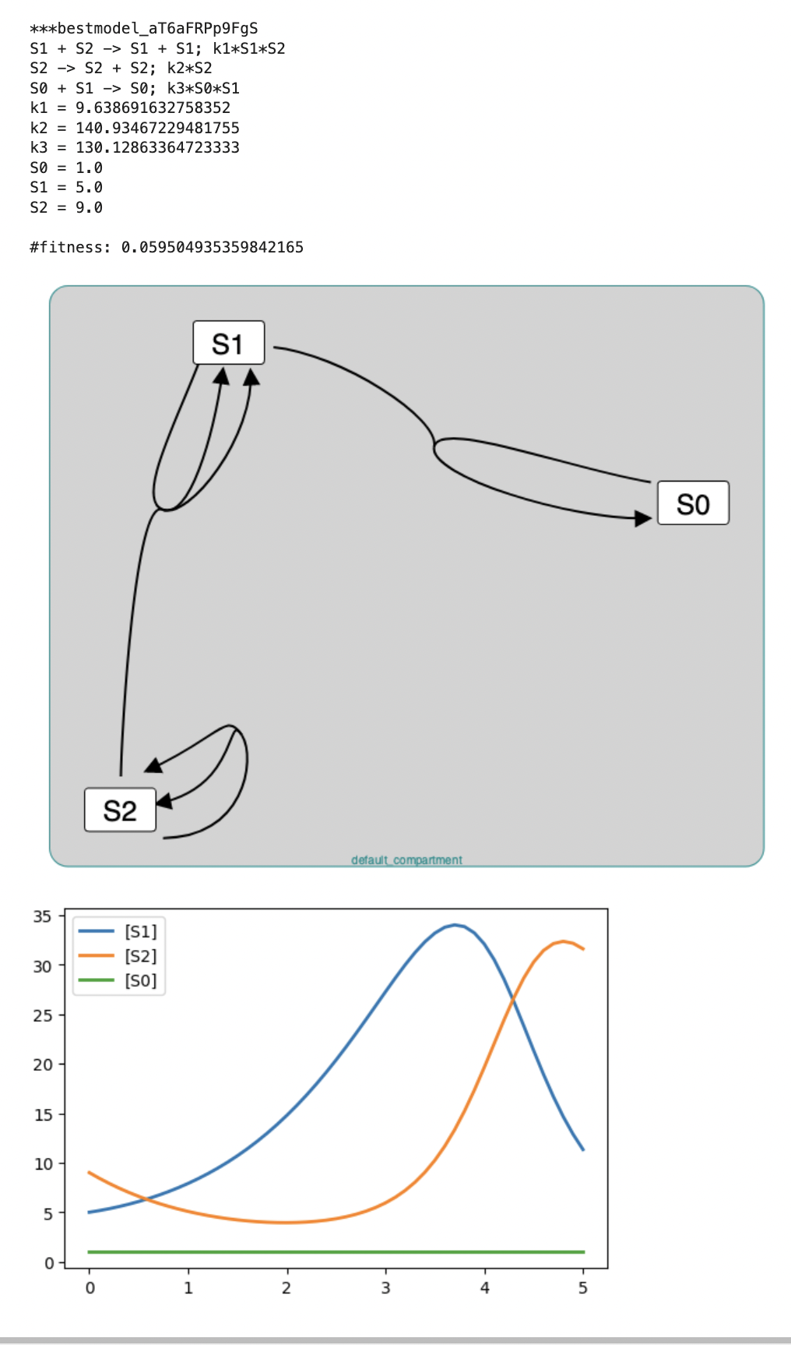
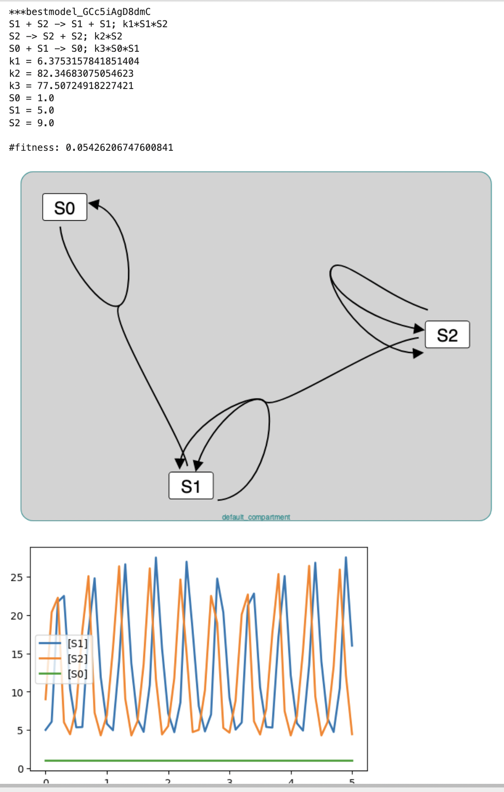
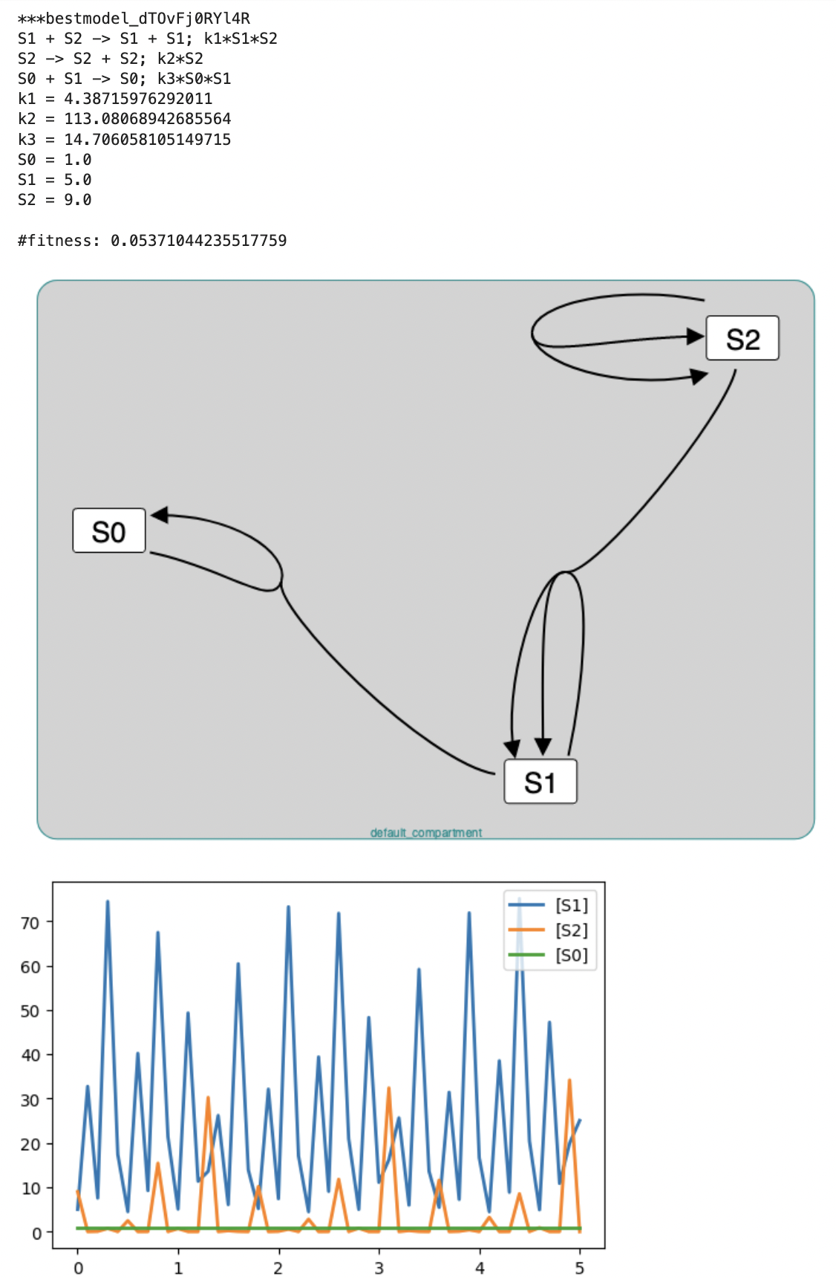
Clustering Problem: Find Structurally Identical Networks In a Large Repository Oscillators_DOE_JUNE_12_B_41373: 66 oscillating networks have the same structure

Slide 4
Approaches to Finding Structural Identical Models in a Large Model Corpus
O(N²), N is number of networks
N is 10,000 to 50,000 in OscillatorDatabase
Naive
for network1 in networks
for network2 in networks
report if network1, network2 are structurally identical
M is 3 to 5 in OscillatorDatabase
Hash
Create a permutably invariant hash for stoichiometry matrices of network in networks
for each unique hash_value
for network1 with hash(network) = hash_value
for network2 with hash(network) = hash_value
report if network1, network2 are structurally identical
O(M²), M is size of largest hash group

Slide 5
Permutably Invariant Hash (piHash) of a Matrix
Definition: Hash value does not change with permutations of the rows and columns of the matrix
Observation
Stoichiometry matrices mostly have values of 0, 1, 2, -1, -2
Examples of permutation independent characteristics
Number of 0s in a row (column). Same for 1s, 2s, -1s, -2s.
Number of values that are not integers -2, …, 2
piHash algorithm
Encode the counts of values of each row (column) as an integer
Sort the encoded values
Hash the sorted encoded values

Slide 6
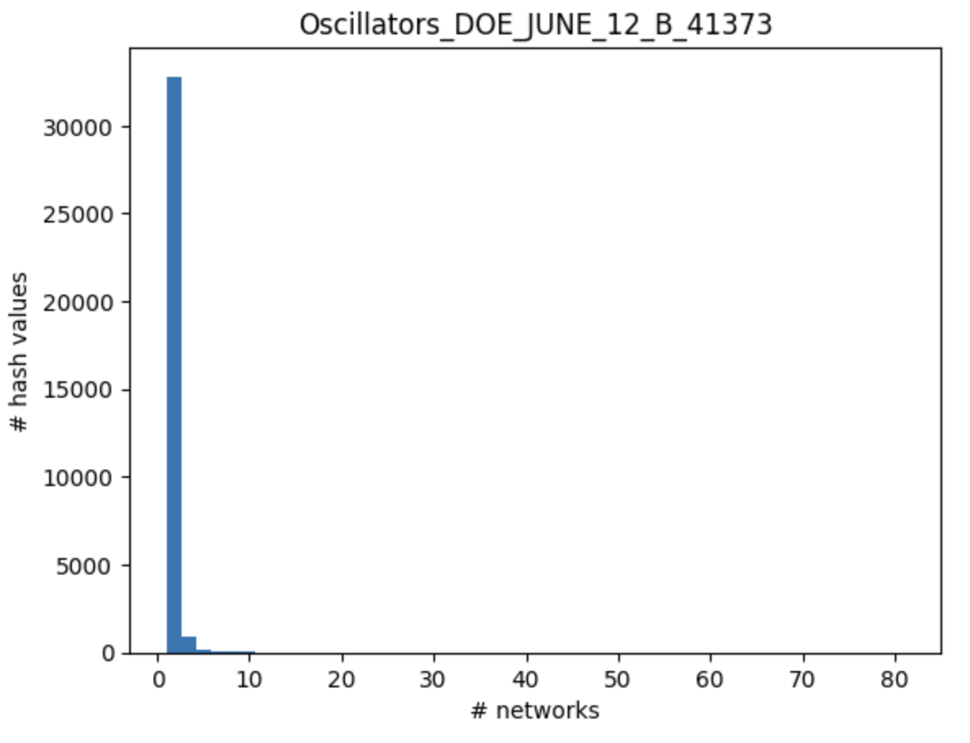
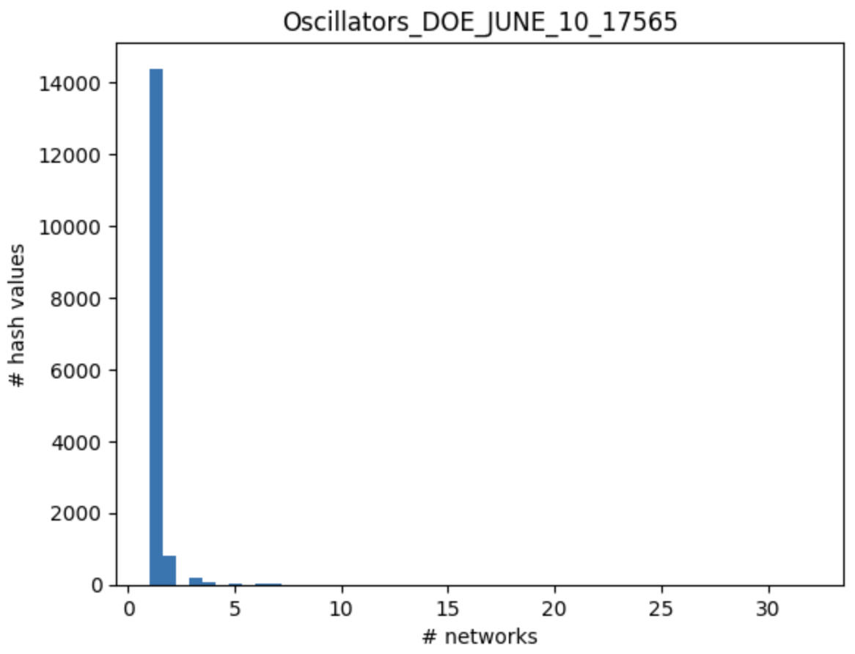
Performance of PIH Hash on Oscillator DB
Complexity is O(25), not O(10**8)
Complexity is O(9), not O(10**8)
M (# networks with the same hash value)
M (# networks with the same hash value)
Both networks have a small percentage of structurally identical models (2% - 5%)

Slide 7
Related Work
nauty – determines if two networks are structurally identical but does not address the clustering problem

Slide 8
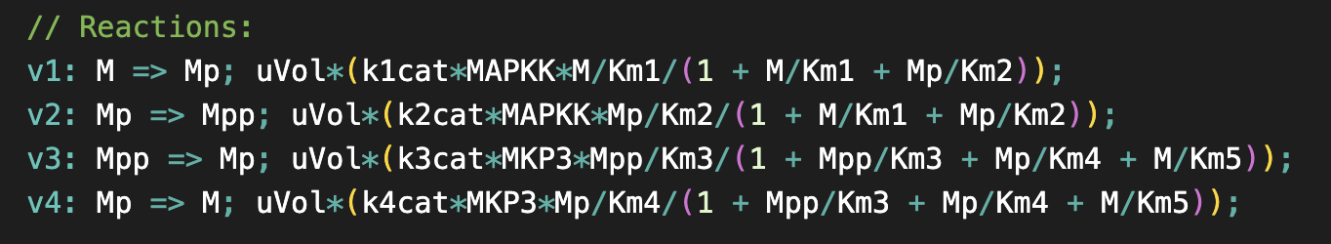
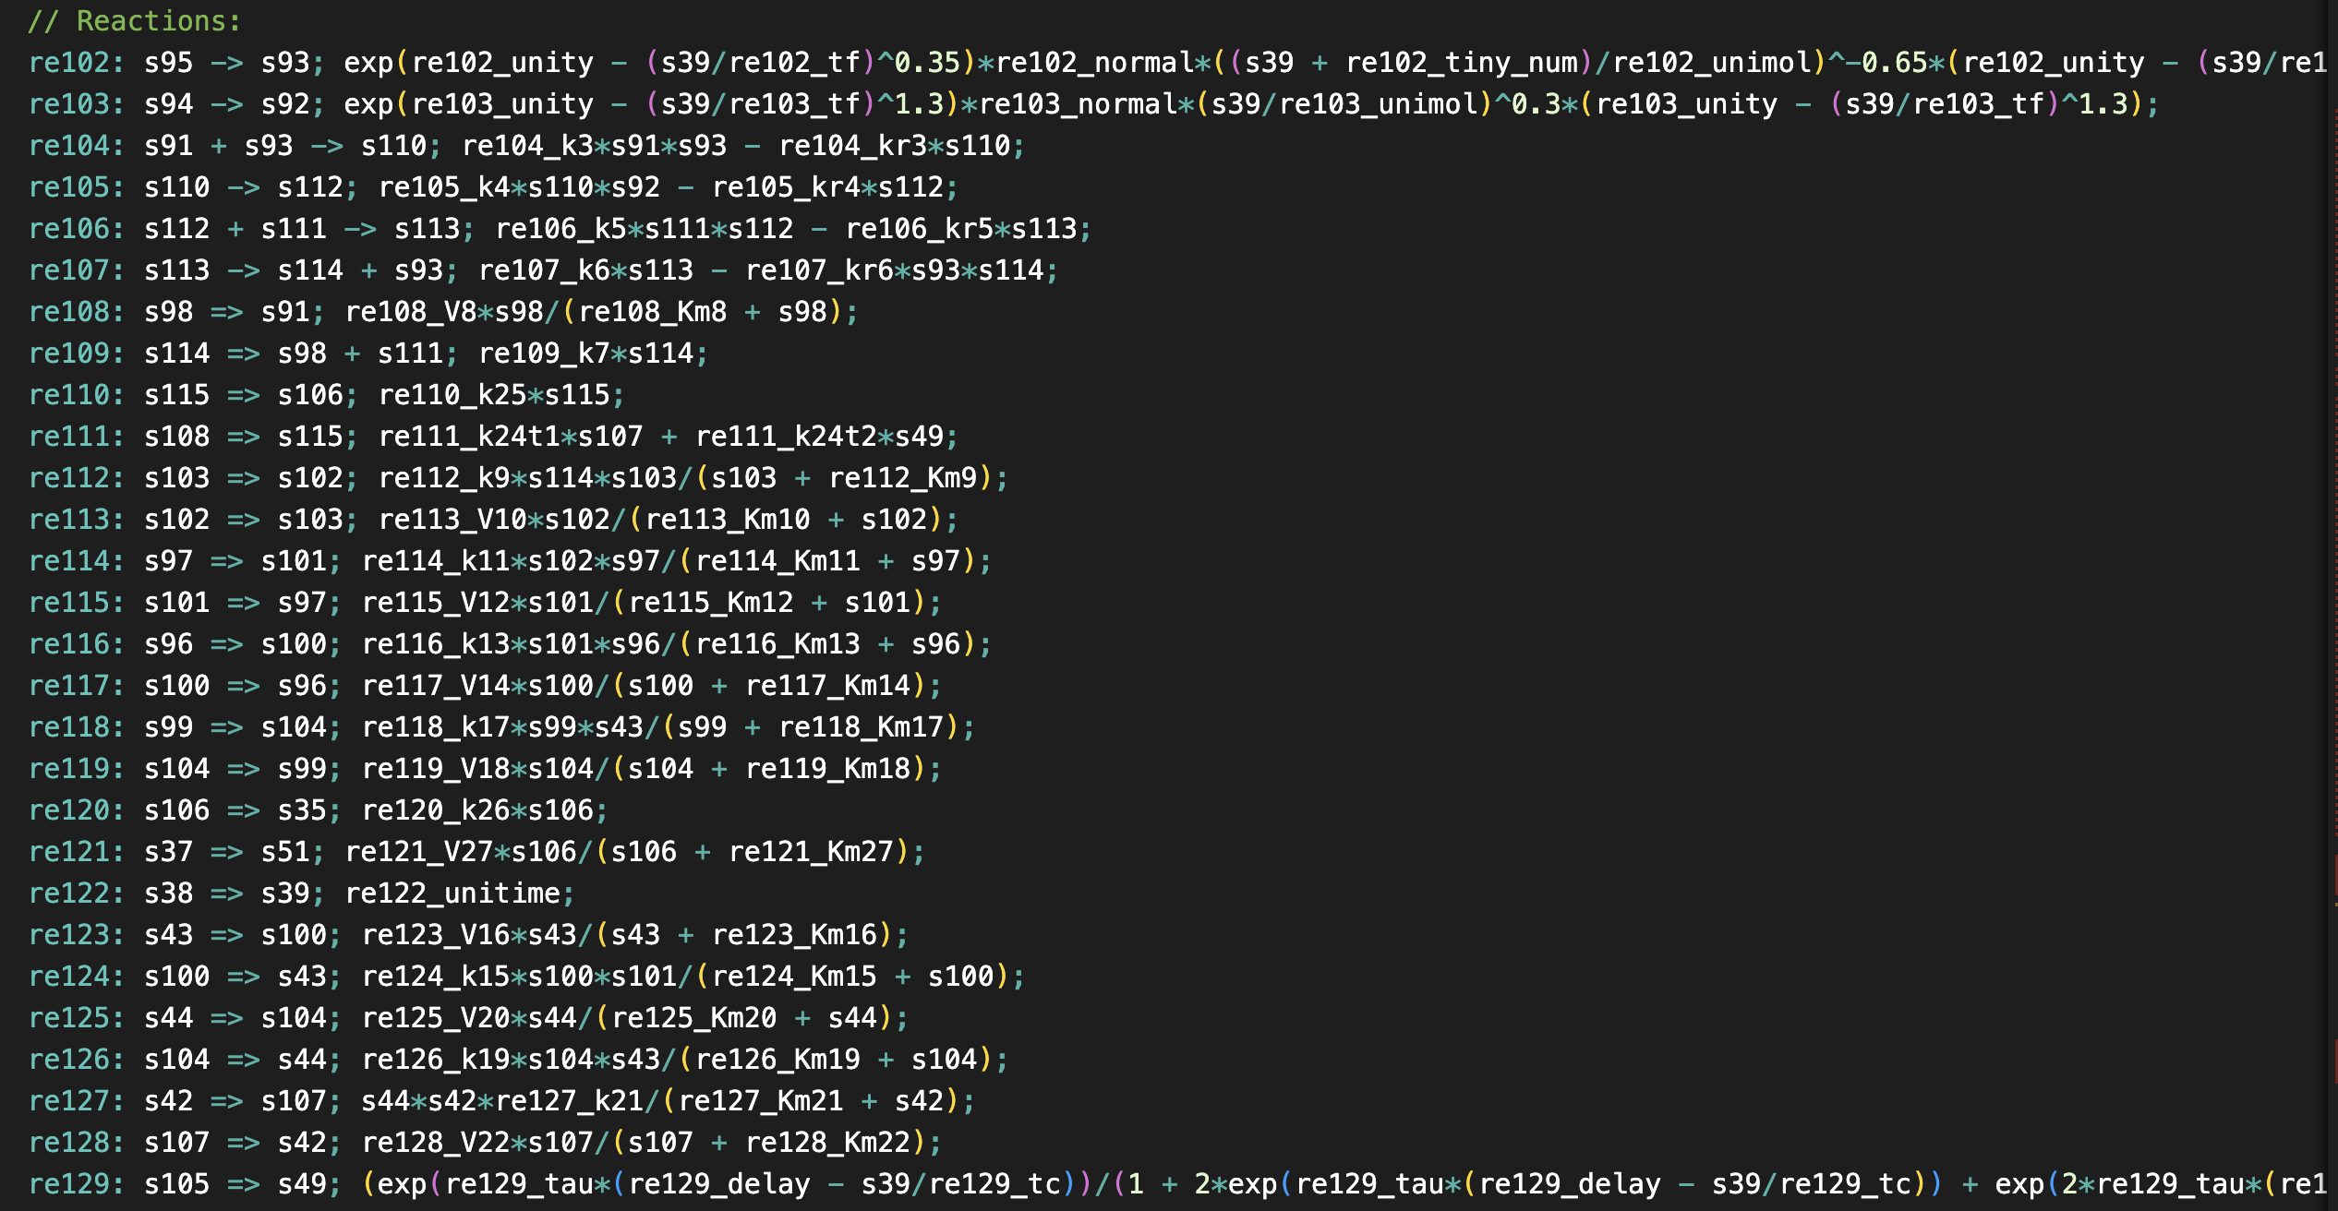
Subnet Problem: Determine if Network A is a Subnet of Network B
BioModels 27
1
2
3
4
Where is 27 inside of 466?
BioModels 466
3
2
1
4

Slide 9
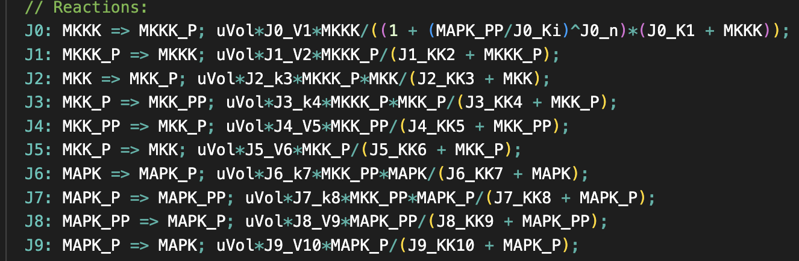
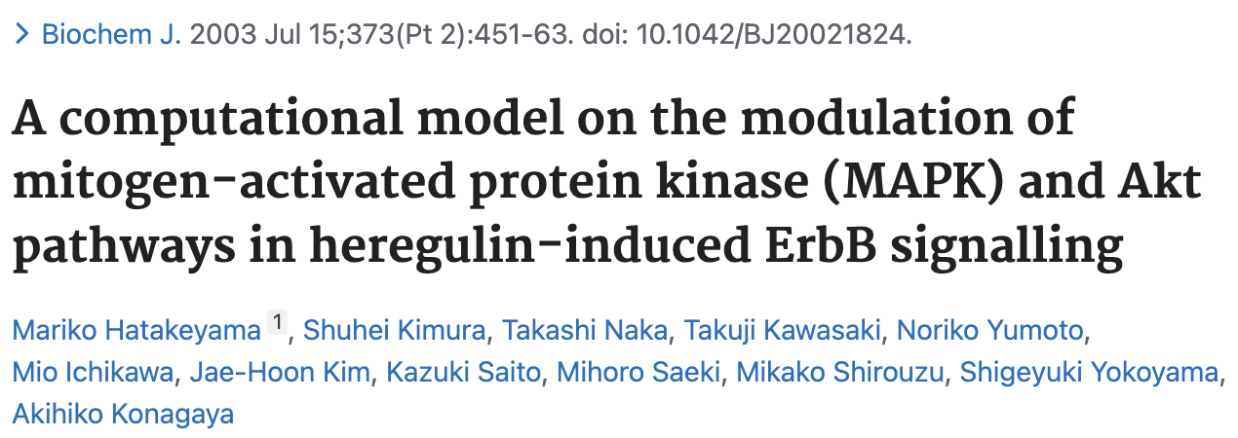
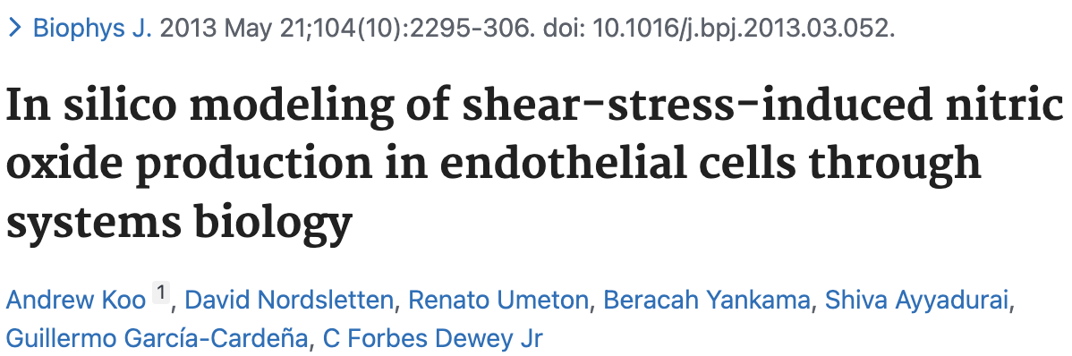

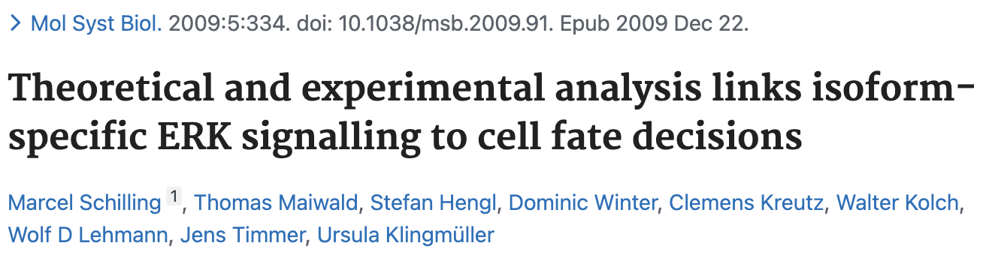
Kholodenko 2000 (10) - Ultrasensitivity and negative feedback bring oscillations in MAPK cascade
What models embed this model?
BioModels 146
BioModels 466
BioModels 468
BioModels 270

Slide 10
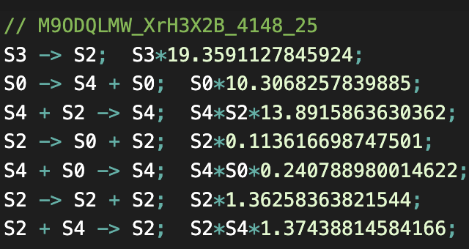
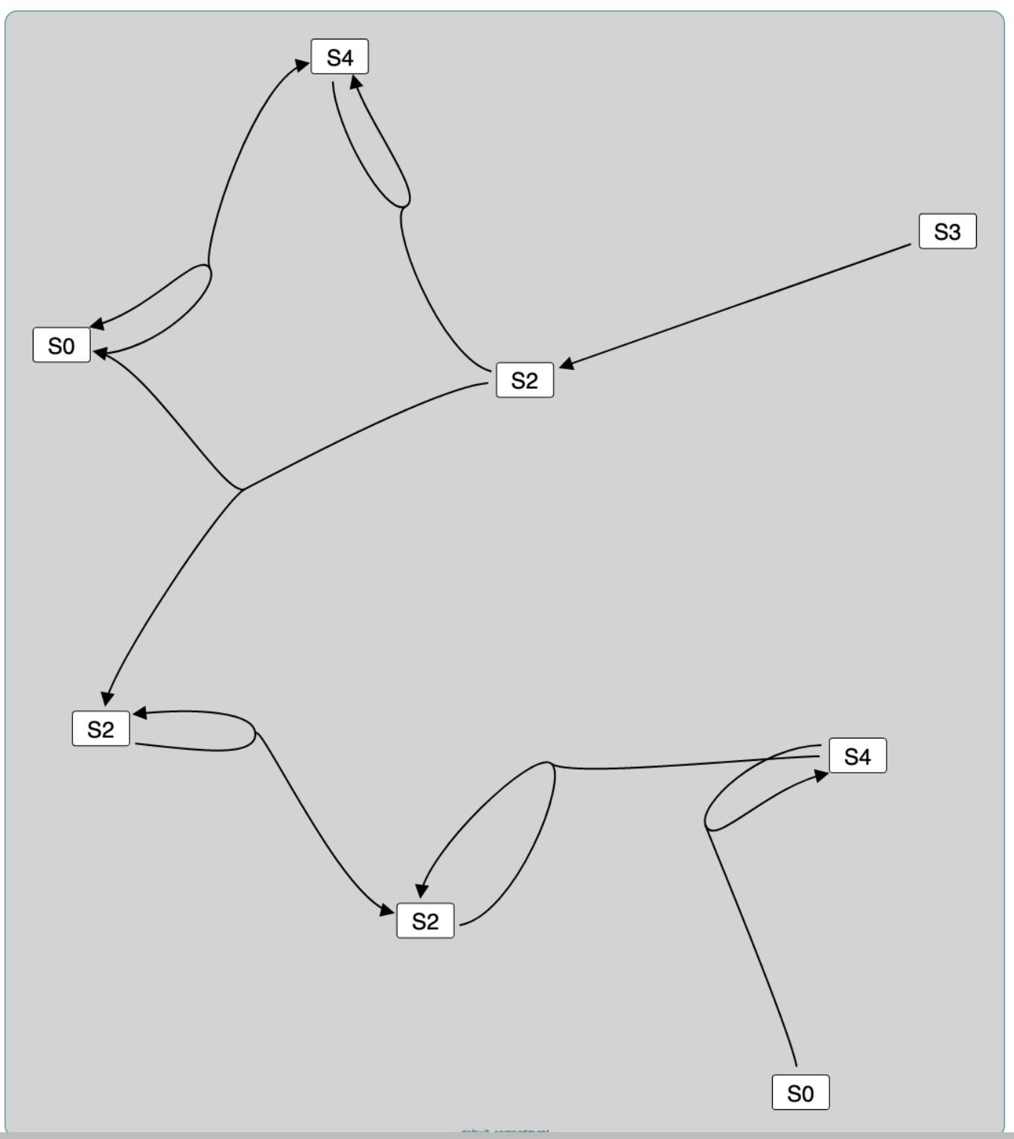
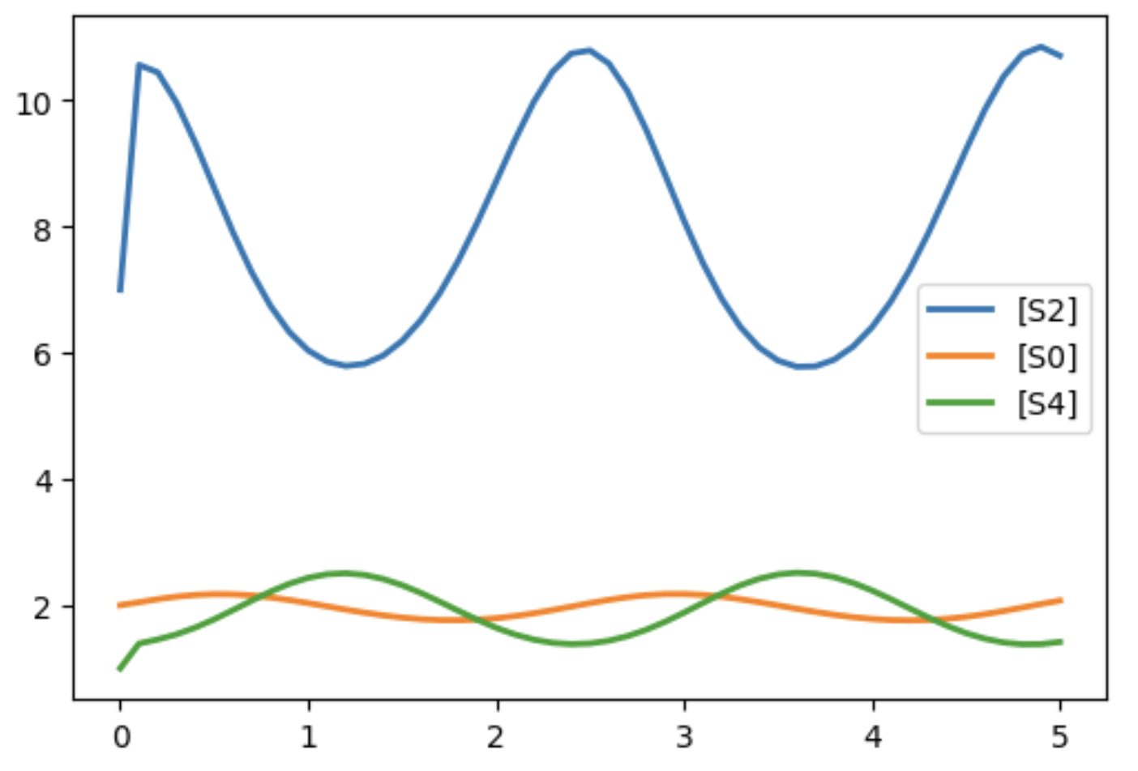
An Oscillator in the Oscillator Database

Slide 11
Subnet Problem: Are there BioModels that contain this oscillator?
FelixGarza2017 (695): Blue light treatment of psoriasis). 35 reactions.
R_13: xFinal_8 -> xFinal_7
R_6: xFinal_3 -> xFinal_3 + xFinal_9
R_15: xFinal_7 + xFinal_9 -> xFinal_9
R_24: xFinal_7 -> xFinal_7 + xFinal_3
R_25: xFinal_3 + xFinal_9 -> xFinal_9
R_14: xFinal_7 -> 2.0 xFinal_7
R_7: xFinal_7 + xFinal_9 -> xFinal_7
Carbo2013 (480): Muscosal immune response during H.pylori infection. 56 reactions.
reaction_16: s1 -> s6
reaction_30: s16 -> s16 + s13
reaction_19: s6 + s13 -> s13
reaction_33: s6 -> s6 + s16
reaction_12: s16 + s13 -> s13
reaction_3: s6 -> 2.0 s6
reaction_39: s6 + s13 -> s6
ArnoldFarquhar2011:(872) RubisCO and the Carbon Cycle. 17 reactions.
re9: s12 -> s13
re5: s2 -> s2 + s4
re14: s13 + s4 -> s4
re1: s13 -> s13 + s2
re3: s2 + s4 -> s4
re24: s13 -> 2.0 s13
re7: s13 + s4 -> s13

Slide 12
Why Find Model Sub-Networks?
Query for models containing structures of interest (e.g., double phosphorylation cycles) to:
Find related work
Select rate laws
Annotate species, reactions
Evaluate the statistical significance of a subnet by
Generating representative random networks
Find if the subnet is present in the random network
Understand higher level structures of chemical networks

Slide 13
Related Work
Running example: R: A + B -> C + D
Related Work
Issue
nauty: Finds identical graphs
Not subgraphs.
Alon 2000: Feedforward loop subnets
Customized search for small subnets in the species graph.
glasgow subgraph solver
Finds subgraphs of source-destination pair graphs (not hypergraphs).
A
(1)
(2)
Doesn’t use hypergraphs so
A -> C is a subgraph
C
R
B
D
(1a)
(2a)
A
C
Finding subgraphs of hypergraphs.
(1)
R
(2)
Some literature. No packages.
No consideration of characteristics of CRNs.
B
D
Conclusion: Finding subnets is a specialized kind of graph analysis.

Slide 14
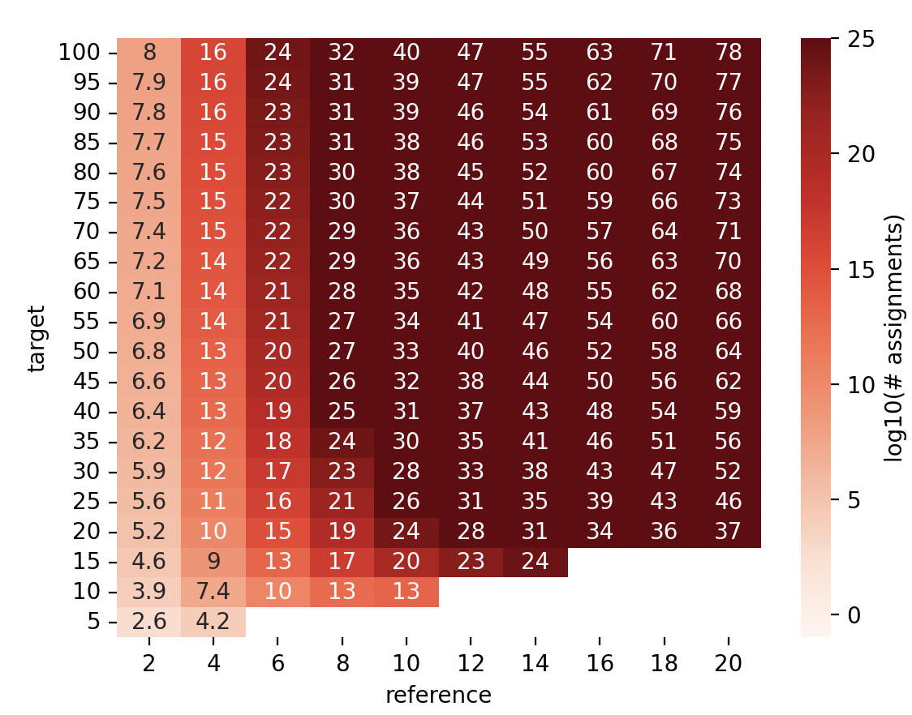
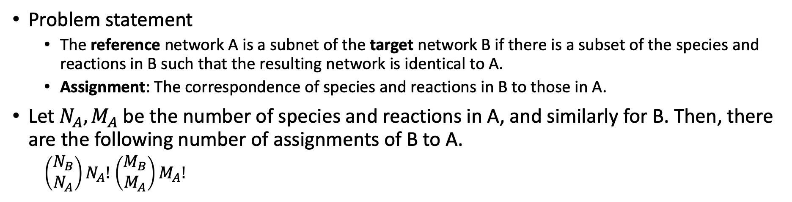
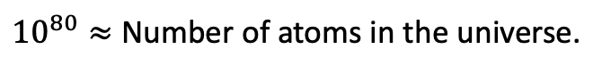
Finding Subnets
Problem statement
The reference network A is a subnet of the target network B if there is a subset of the species and reactions in B such that the resulting network is identical to A.
Assignment: The correspondence of species and reactions in B to those in A.
Let $N_{A}, M_{A}$ be the number of species and reactions in A, and similarly for B. Then, there are the following number of assignments of B to A.
$\left(\begin{matrix}N_{B} \\ N_{A}\end{matrix}\right)N_{A}!$ $\left(\begin{matrix}M_{B} \\ M_{A}\end{matrix}\right)M_{A}!$
$10^{80}≈$ Number of atoms in the universe.
(number species = number reactions)
Notes:
Range of values evaluated are appropriate for the size of models in BioModels.

Slide 15
Strategy
Construct easy-to-calculate constraints for reference networks that reduce the number of assignments.
Increase the speed of assessing constraints by parallelization.

Slide 16
Constraints On Assignments for Chemical Reaction Networks
Reaction constraints
Type of reaction (e.g., uni-uni, uni-bi, bi-uni)
Type of destination reactions (in inferred reaction monopartite graph)
Autocatalysis reaction
Species constraints
Occurrences of species in each type of reaction as a reactant
Occurrences of species in each type of reaction as a product
Autocatalyzed species
Constraints are represented as numpy arrays and their analysis is vectorized.
Benchmark evaluation
Generate networks based on the distribution of reaction types in BioModels

Slide 17
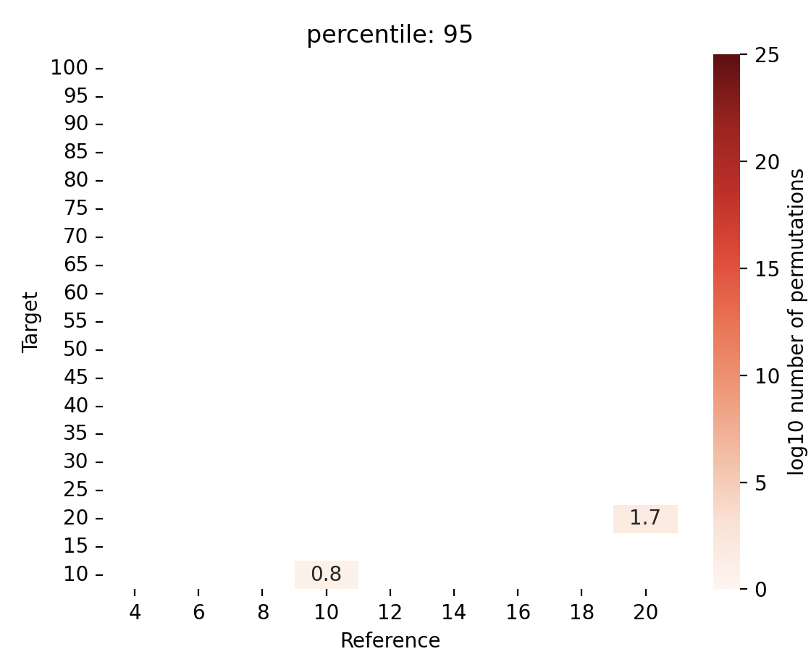
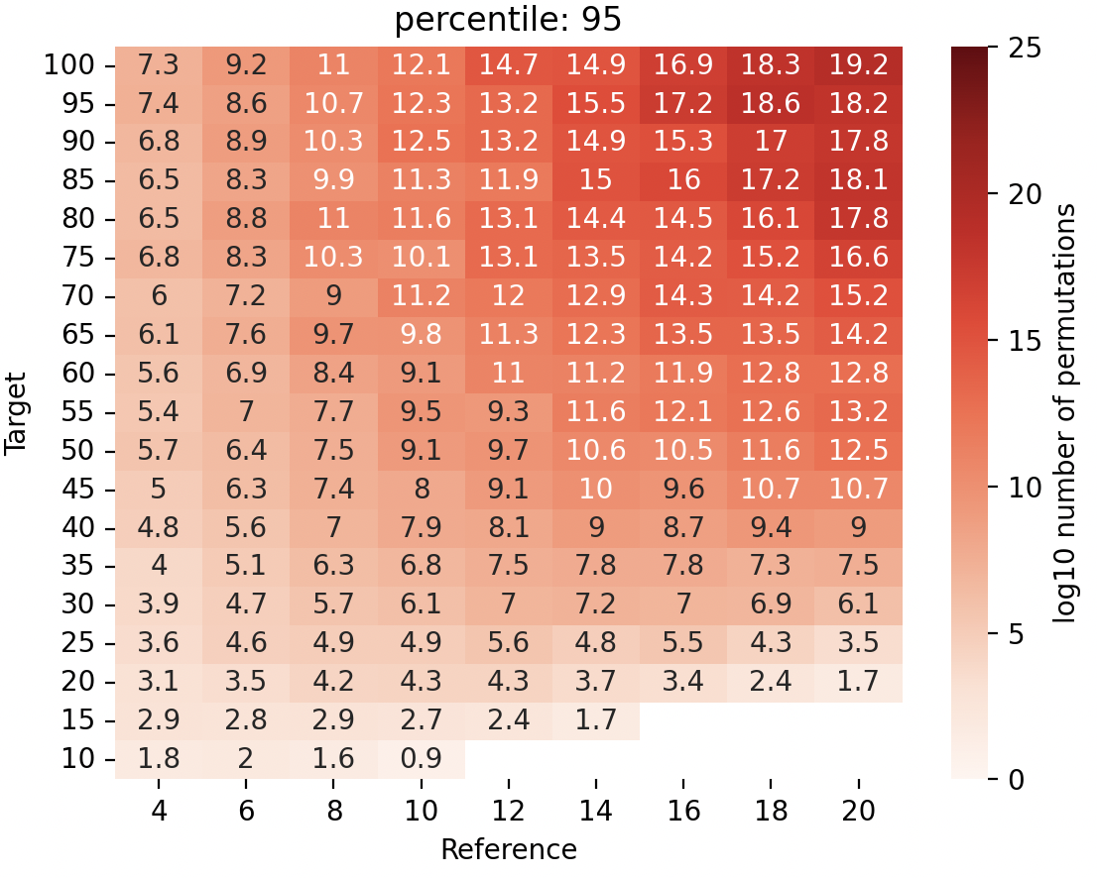
Constraints reduce the number of assignments
No Constraints
Reference Network Absent
Reference Network Present
95 percentile w/Constraints
95 percentile w/Constraints

Slide 18
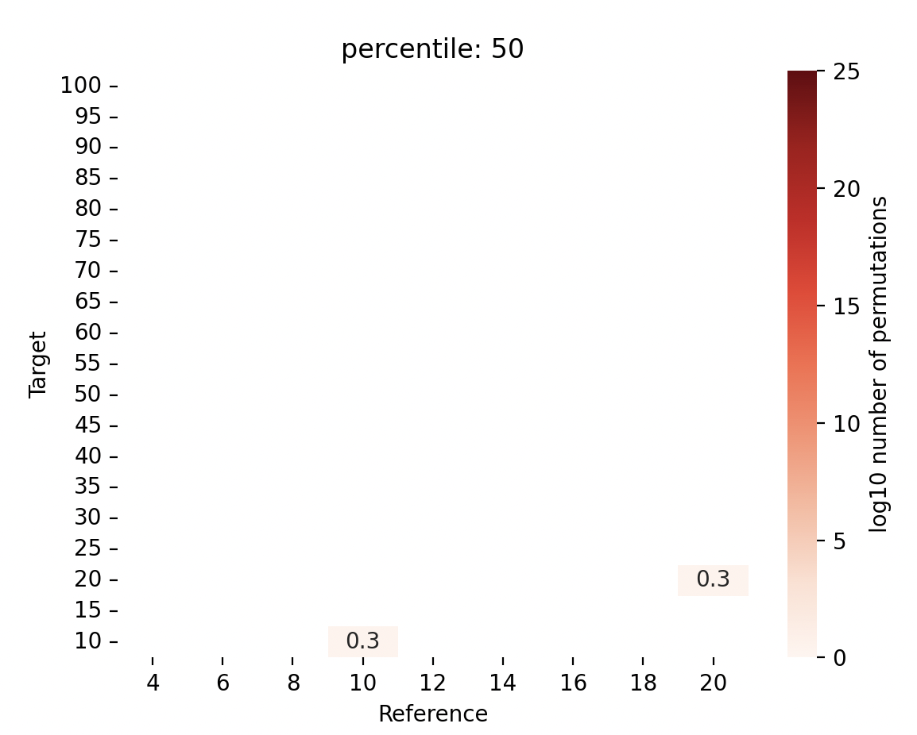
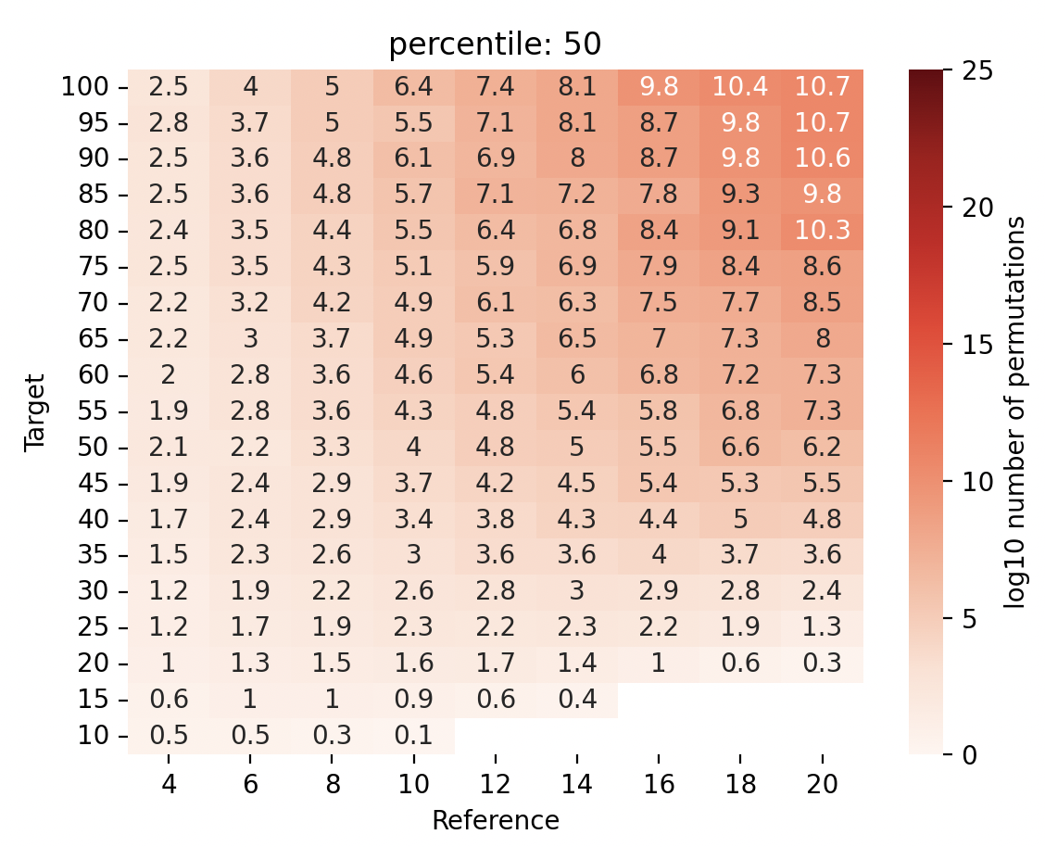
Constraints reduce the number of assignments to consider
Reference Present
95 percentile w/Constraints
No Constraints
Reference Absent
Reference Present
50 percentile w/Constraints
50 percentile w/Constraints

Slide 19
Parallelism
Vectorization
Evaluate many assignments simultaneously by proper memory layouts
Process parallelization
Use python multiprocessing to run many vectorizing processes at once.
Results
No parallelism: ~100K Assignment/s
Vector parallelism: ~1M Assignment /s
Vector + 10 process parallelism: ~10 M/s
~1 day to evaluate 10¹² assignments with 20 M1 mac cores

Slide 20
Contributions
piHash algorithm for scalable discovery of structurally identical models.
Scalable constraint-based approach to finding sub-networks.
Open-source python package that provides (1) and (2).
Application to Oscillator Database and BioModels.

Slide 21
Next Steps
Review with Anatasia
Create a package
More detailed analysis of BioModels

Slide 22
BACKUP

Slide 23
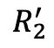
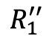
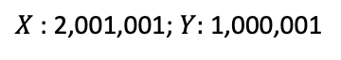
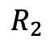
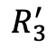
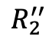
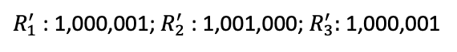
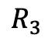
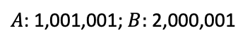
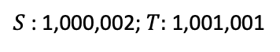
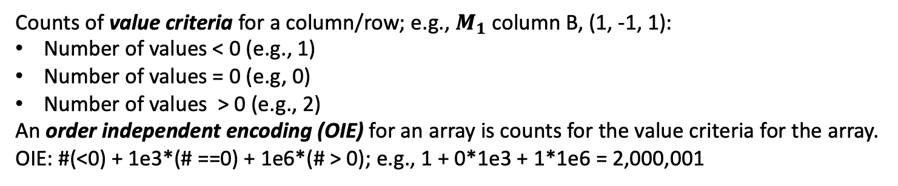
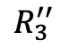
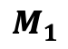
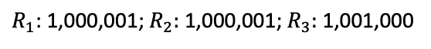
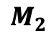
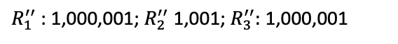
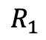


Order Independent Encoding (OIE) of Arrays
Counts of value criteria for a column/row; e.g., $M_{1}$column B, (1, -1, 1):
Number of values < 0 (e.g., 1)
Number of values = 0 (e.g, 0)
Number of values > 0 (e.g., 2)
An order independent encoding (OIE) for an array is counts for the value criteria for the array.
OIE: #(<0) + 1e3*(# ==0) + 1e6*(# > 0); e.g., 1 + 0*1e3 + 1*1e6 = 2,000,001
$$M_{1}$$
 | A | B
 | -1 | 1
 | 1 | -1
 | 0 | 1
$$M_{2}$$
 | X | Y
 | 1 | -1
 | 1 | 0
 | -1 | 1
$$M_{3}$$
 | S | T
 | 1 | -1
 | -1 | 0
 | -1 | 1
$$R_{1}$$
$$R_{1}^{′}$$
$$R_{1}^{′′}$$
$$R_{2}$$
$$R_{2}^{′}$$
$$R_{2}^{′′}$$
$$R_{3}$$
$$R_{3}^{′}$$
$$R_{3}^{′′}$$
$R_{1}$: 1,000,001; $R_{2}:$1,000,001; $R_{3}:$1,001,000
$R_{1}^{′}$: 1,000,001; $R_{2}^{′}$: 1,001,000; $R_{3}^{′}:$1,000,001
$R_{1}^{′′}$: 1,000,001; $R_{2}^{′′}$1,001; $R_{3}^{′′}:$1,000,001
$A$: 1,001,001; $B:$2,000,001
$X$: 2,001,001; $Y:$1,000,001
$S$: 1,000,002; $T:$1,001,001

Slide 24
















DSIRN: Detecting Structurally Identical Reaction Networks: 2
1,001,001
2,000,001
1,001,001
2,000,001
$$M_{1}$$
 | A | B
 | -1 | 1
 | 1 | -1
 | 0 | 1
$$M_{2}$$
 | Y | X
 | -1 | 1
 | 1 | -1
 | 0 | 1
1,000,001
$$R_{1}$$
?
1,000,001
$$R_{1}^{′}$$
1,000,001
$$R_{2}$$
$$=$$
1,000,001
$$R_{3}^{′}$$
1,001,000
$$R_{3}$$
1,001,000
$$R_{2}^{′}$$
1,001,001
2,000,001
1,001,001
2,000,001
$$M_{1}$$
 | A | B
 | -1 | 1
 | 1 | -1
 | 0 | 1
$$M_{2}$$
 | Y | X
 | -1 | 1
 | 1 | -1
 | 0 | 1
1,000,001
$$R_{1}$$
?
1,000,001
$$R_{1}^{′}$$
1,000,001
$$R_{2}$$
$$=$$
1,000,001
$$R_{3}^{′}$$
1,001,000
$$R_{3}$$
1,001,000
$$R_{2}^{′}$$

Slide 25
Bipartite Hypergraphs Are Required to find Subnets
Consider the network with one reaction: R: A + B -> C + D
The bipartite hypergraph representation is depicted below. There are 5 nodes: 4 species nodes and 1 reaction node. There are two hyperarcs, (1) and (2).
A
C
(1)
R
(2)
B
D
The hyperarcs are required in order to have the correct semantics for finding a subset of the model. Below is a graph without hyperarcs. That is, the arc (1) represents (A, R), etc. In this case, the reaction A->C is a subgraph, which is not a correct interpretation of a subset of a reaction network.
(1)
(2)
A
C
R
B
D
(1a)
(2a)

Slide 26
Reference network
Construct constraints for reference network
Construct compatibility vector
Prune compatibility vector
Target network
Construct constraints for target network
Expand pruned compatibility vector into assignments
Calculate assignment pairs

Slide 27


Computational Complexity of Naïve Algorithm to Detect Weak Structural Identical
Naïve Algorithm
def isPIdentical(M1:matrix, M2:matrix):
for rp in reaction_permutations
for sp in species_permutations
if M1[rp, sp] == M2;
return True
return False
--age of universe
--millennium
--century
--year
--day
Computational complexity: $O(N!M!)$
N is number of reactions
M is number of species
--hour
--second
Long compute times on modest size networks:
5 species, 10 reactions
1.5 hrs (Mac M1, 12 usec/comparison)
log₁₀ (hour) on mac M1

